Slide 1
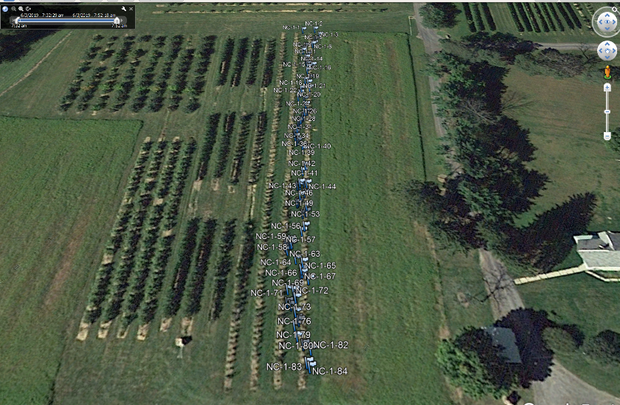
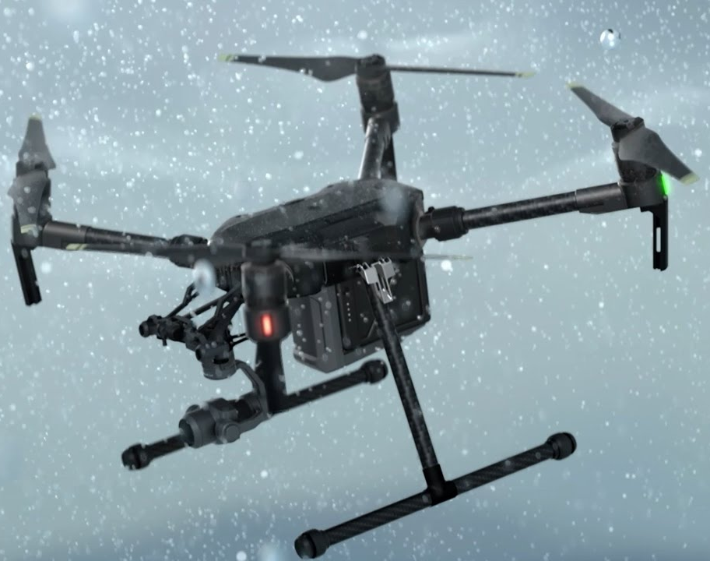
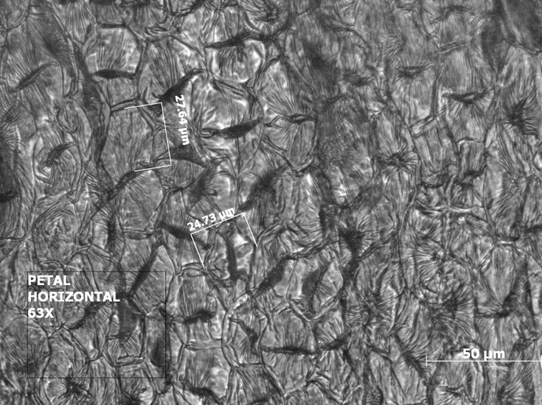
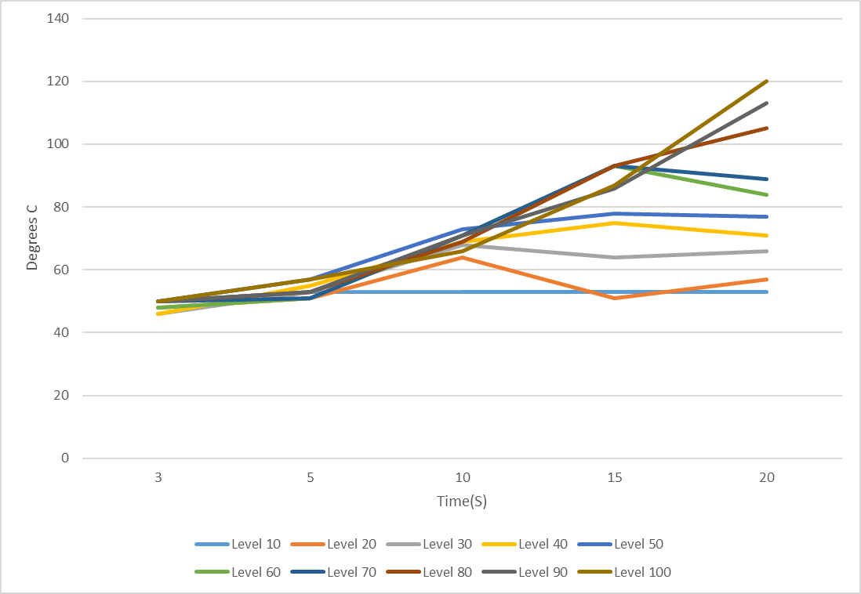
CPS: Medium: Integrated Design of Sensing, Network, and Cooperative Control of Multi-Vehicle Systems for Preventing Frost and Freeze Damage to Flowers and Buds of Fruit Trees
David James Lyons PhD
Autonomy Perception and Cognition Department
Summer 2019

Slide 2
Platform(s) Communication
Spatial Data Manager Suite
Decision Space Analysis
UGV Heating system
Preliminary Study

Slide 3
Communication Key
Wi-Fi
Serial (USB to TTL)
RF
Communication Overview
Flight path (way points)
FLIR grid (x,y) position
UAV
Flight commands
DJI
Flight
Controller
ODROID
FLIR camera
FLIR images
battery level
BASE
STN.
DJI
Remote
∆T (leaving - arrival)
Battery level
Safeguard Default Interrupt
UGV
Driving commands
Husky Motor
Controller
ODROID
grid (x,y) position
boolean activation of dragon
FAH

Slide 4
ROS File Schema
In ROS filesystems a hierarchy must be applied in order to allow for consistent and trouble-free launches when running the full system network for the base station and UAV/UGV. The format is created within the dji_sdk package as a centralized location and each subsection lies within its relevant folder. Multiple mid-level launch files and low-level nodes will exist and called using the master launch file. The overall format is as follows, each point represents an individual file:
Launch master file (using <include>)- xml
Launch file(s)- xml
Node(s) (publisher/subscriber/client/server)- Python

Slide 5
ROS File Syntax
ROS does not specifically require a file name hierarchy or syntax thus one was created for the project in order to maintain consistency. In order to differentiate nodes and launch files based on their responsibilities, a suffix-based syntax will be maintained among all ROS files and scripts. The rules are as follows:
All top and mid-level launch files will be specific to the vehicle they operate. Ending in “_uav” or “_ugv” (ex. “gui_launch_uav.launch”)
Publisher/subscriber (topic) nodes will end in “_sub” or “_pub”. (ex. “battery_state_sub”)
Client/server (service) nodes will end in “_cli” or “_serv”. (ex. “mission_waypoint_upload_cli”)
*No capital letters will be used in any filename. Exceptions to the above syntax will be made for dji_sdk based nodes to minimize issues with addressing filenames in pre-written scripts and launch files. NOTE: All python based node scripts also require “.py”

Slide 6
ROS UAV Framework
Publisher/Subscriber Communication
Client/Server Communication
Node
Key
Onboard Odroid
Base Station
Dji_sdk package
Mission Flight Control
Mission Flight Control
Mission_waypoint_action_serv
TCP/IP
(client/server)
Mission_waypoint_action_cli
Mission_waypoint_upload_serv
Mission_waypoint_upload_cli
GUI
GUI
Battery_pub
Flight
_status_pub
UDP
(Pub/Sub)
Battery_sub
Flight
_status_sub
Height
_above
_takeoff_pub
Height
_above
_takeoff_sub
Velocity_pub
Velocity_sub

Slide 7
Temperature Monitoring Agent
INPUT DATA
OUTPUT DATA
Temp. Monitor Agent:
Interpret cooling rate for flagged areas
Create path plan for UGV to heat areas
GPS-based temperature values
UAS+FLIR
GPS path plan
UGV
GPS coordinates of flagged areas

Slide 8
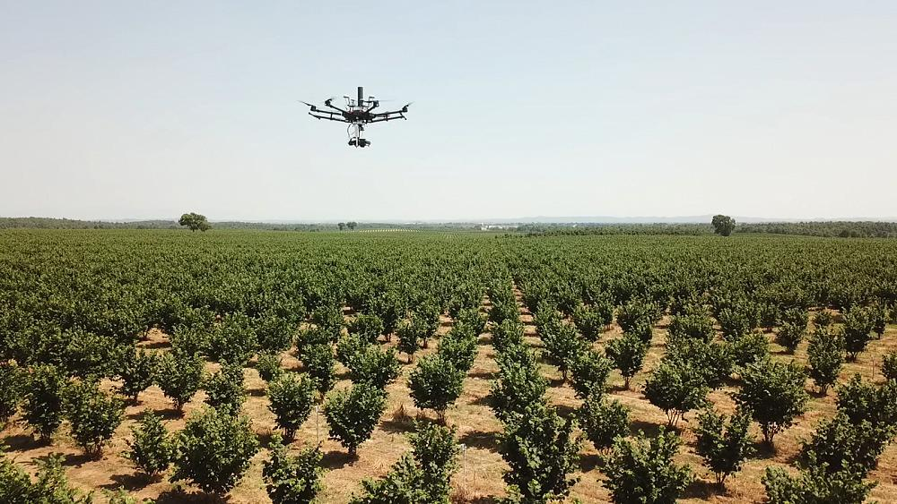
Spatial Data Manager (SDM) Parameters
Gimbal Field of View (FOV)
Gimbal Angle (Θ)
UAS Height (AGL)
Θ

Slide 9
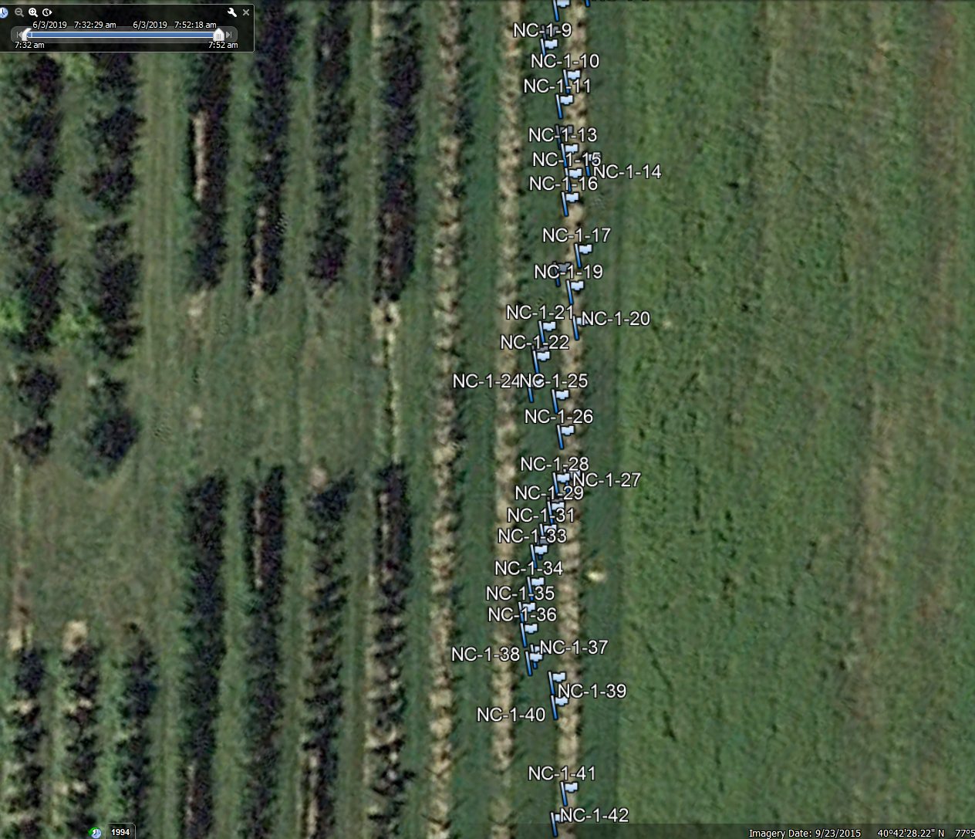
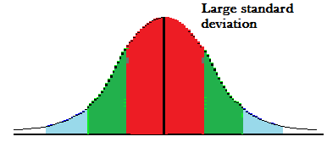
GPS: Standard deviation 1.25 [m]
Target width 0.6 [m]
Target length 1.21 [m]
Row spacing 3.0 [m]
*all numbers are approximate
GPS and Target size are the same order of magnitude.

Slide 10
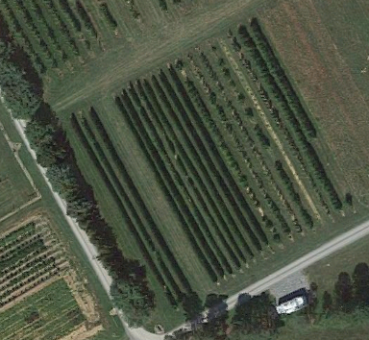
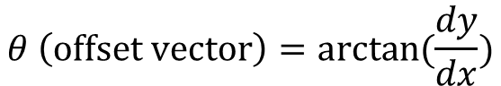
Field Coordinate Transform (Global to Fixed Region)- Block A1 Example
Θ
dy
Y (North)
Fixed Region Coordinates (x,y)
dx
$$θ \left(offset vector\right)=arctan(\frac{dy}{dx})$$
Global Coordinate System (X,Y)
X (East)
Reference trees

Slide 11
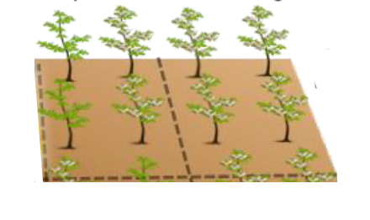
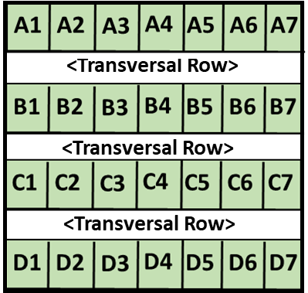


Encoding of GPS latitude & longitudinal positions to a spatial grid map used for reasoning in the decision space.

Slide 12
Ground Station Decision Tree
Ambient temperature below T_{crit}?
Begin path planning
R value variance of last flight pictures compared to baseline images
Battery life >15%?
Return error value
Grid areas previously/soon to be heated by UGV
Deploy drone
Repeat ambient temperature reading
Thermistor sensor reading
Deploy initialization stage
Path planning
considered variables
Deploy decision

Slide 13
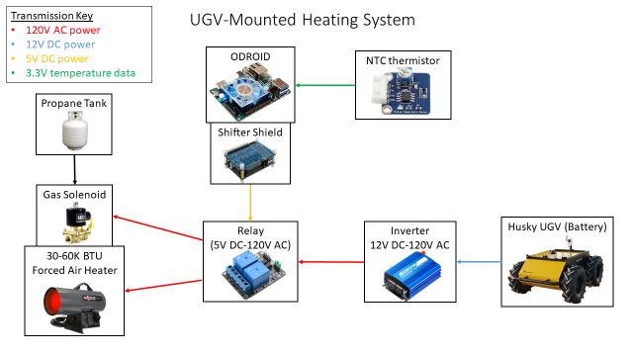

Slide 14

Preliminary Study for EMF exposure
Healthy Flower
Magnified at 63x
Average cell size is ~30 micrometer
Cell Count ~60
Baseline image of a healthy cell.

Slide 15
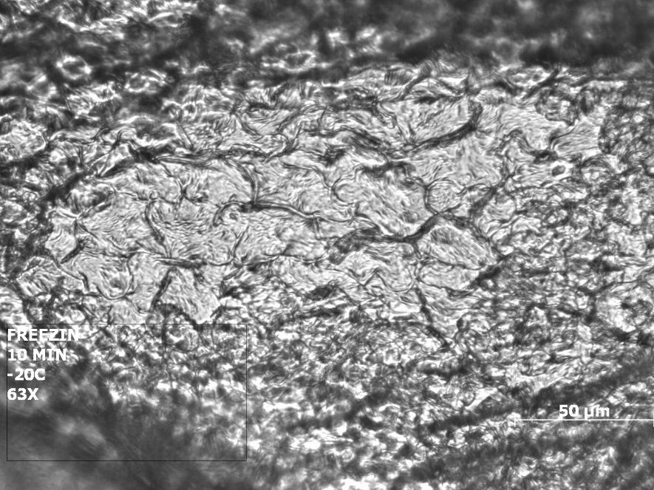
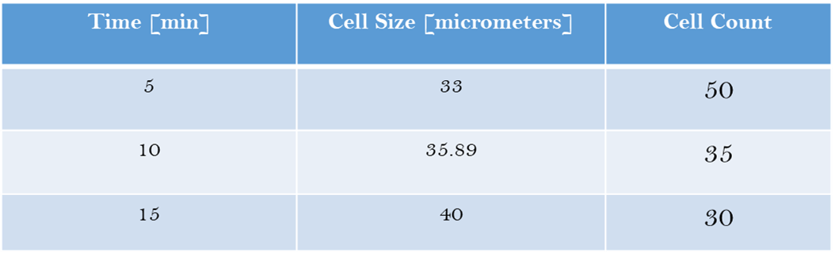
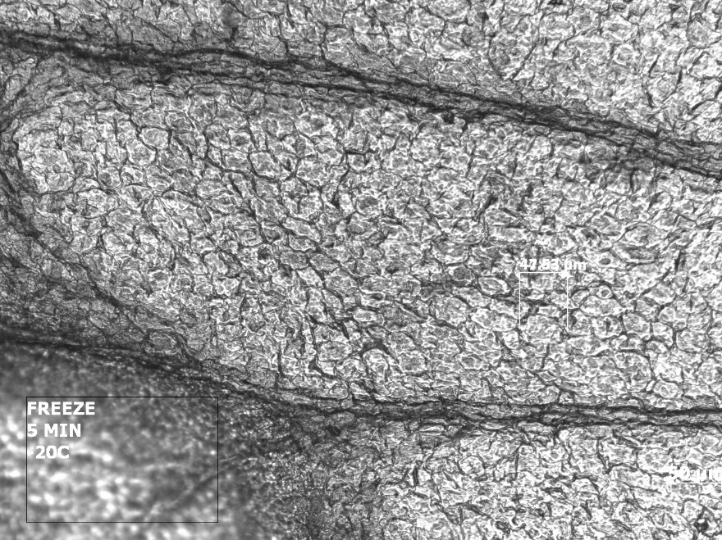
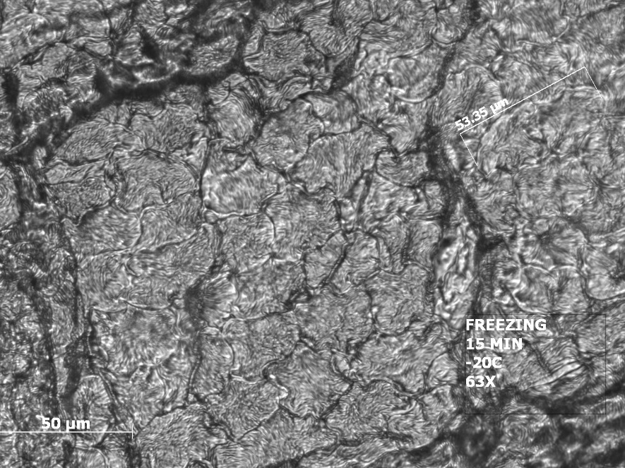
I. Frozen Flower at -20°C
Baseline
Ten minutes at -20°C
Five minutes at -20°C
Fifteen minutes at -20°C

Slide 16
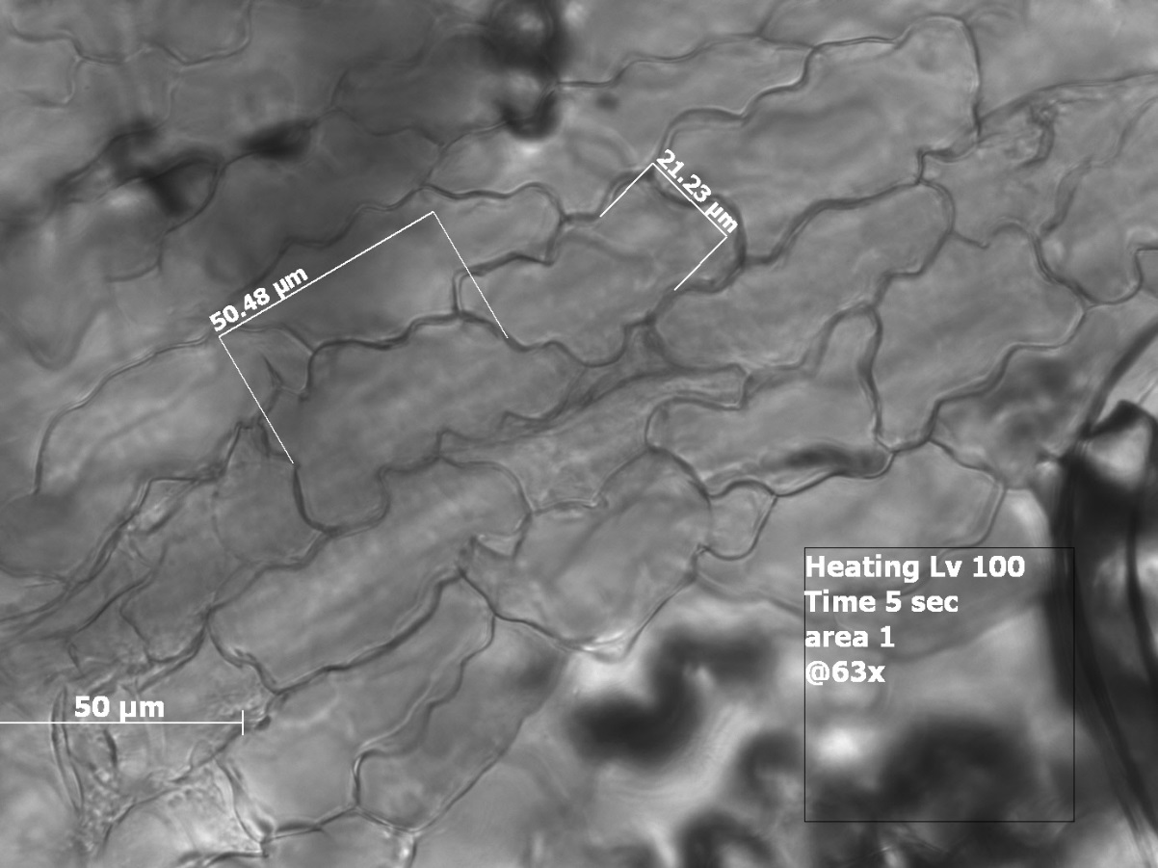
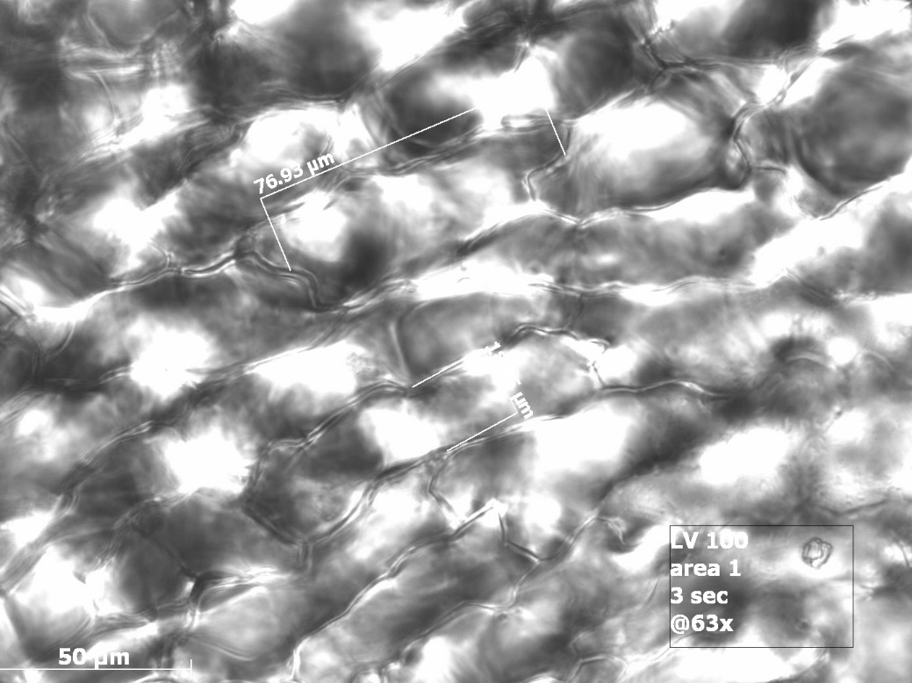
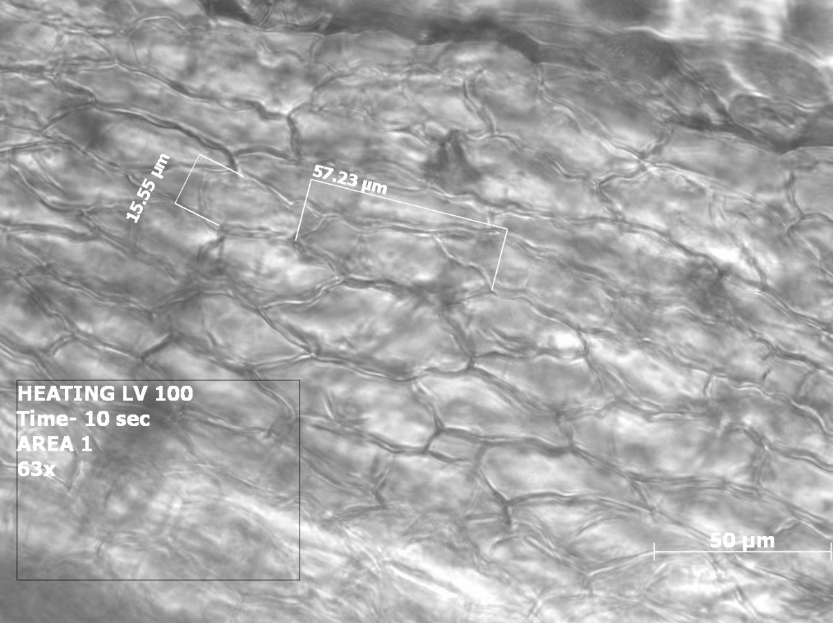
II. Heated Blossoms
Baseline
Five seconds
Three seconds
Ten seconds

Slide 17
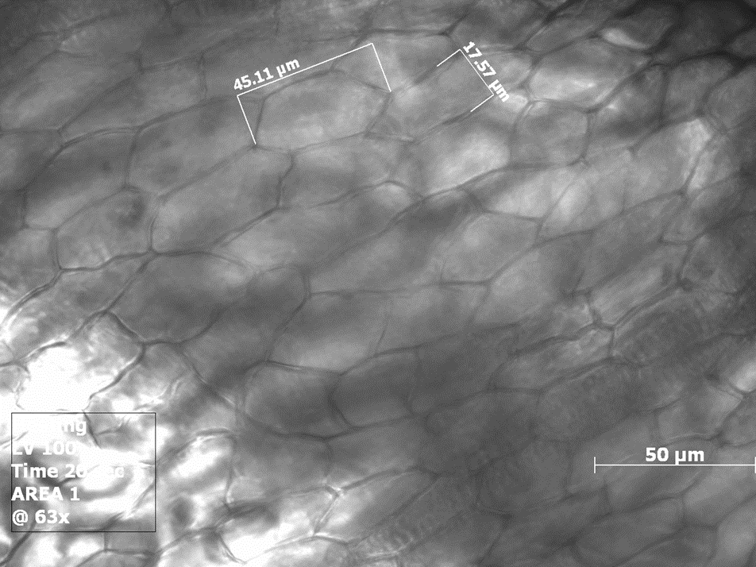
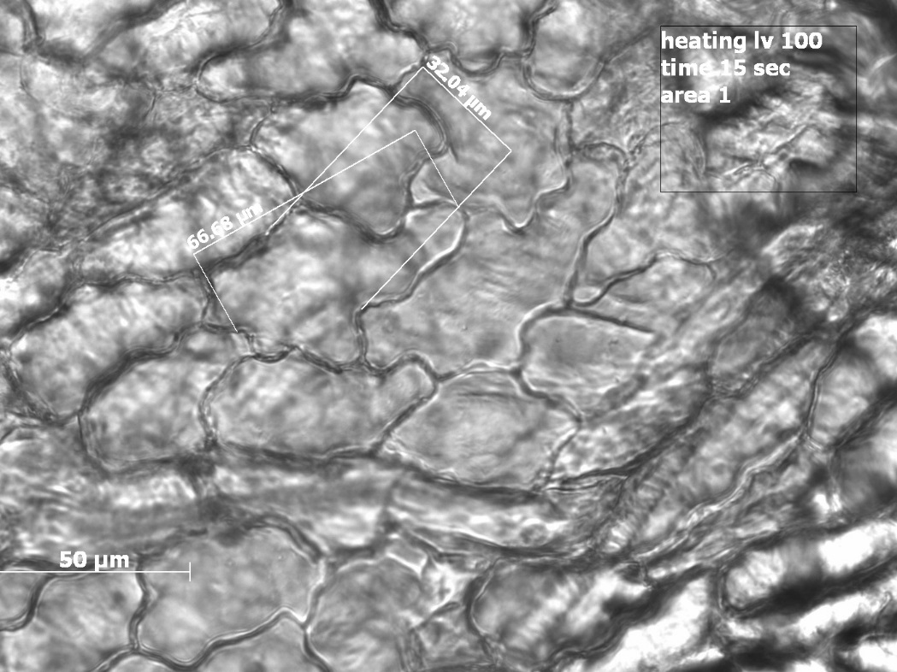
III. Heated Blossoms
Baseline
Twenty seconds
Time [seconds] | Cell Size [micrometers] | Cell Count
3 | 70-80 | 20
5 | 50-70 | 25
10 | 50-60 | 40
15 | 50-60 | 30
20 | 45-50 | 50
Fifteen seconds

Slide 18
END

